Slide 1
Bots, Adaptive Cards, Task Module, Message Extensions in Microsoft Teams
Jenkins NS

Slide 2


Hi! I am Jenkins NS
Modern Workplace Solution Architect
International Speaker
Trainer
@ JPOWER4 (http://www.jpower4.com/)
jenkinsns@jpower4.com
jenkinsns@gmail.com
@jenkinsns
My Blog Posts : http://www.Jenkinsblogs.com
SPFx: https://www.facebook.com/spfxinfo/
MS Teams: https://www.facebook.com/msteamsinfo
Github : https://github.com/jenkinsns

Slide 3
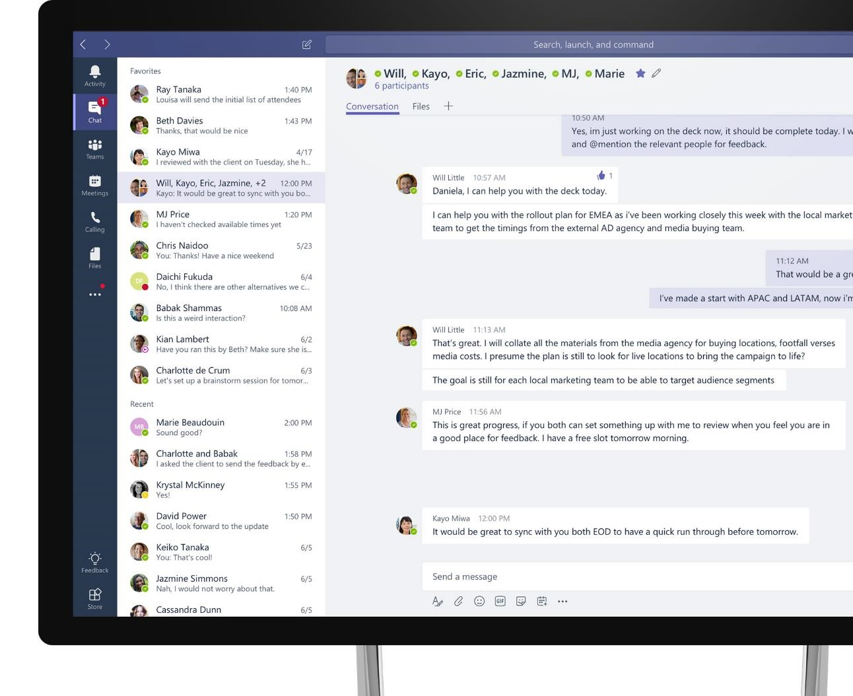
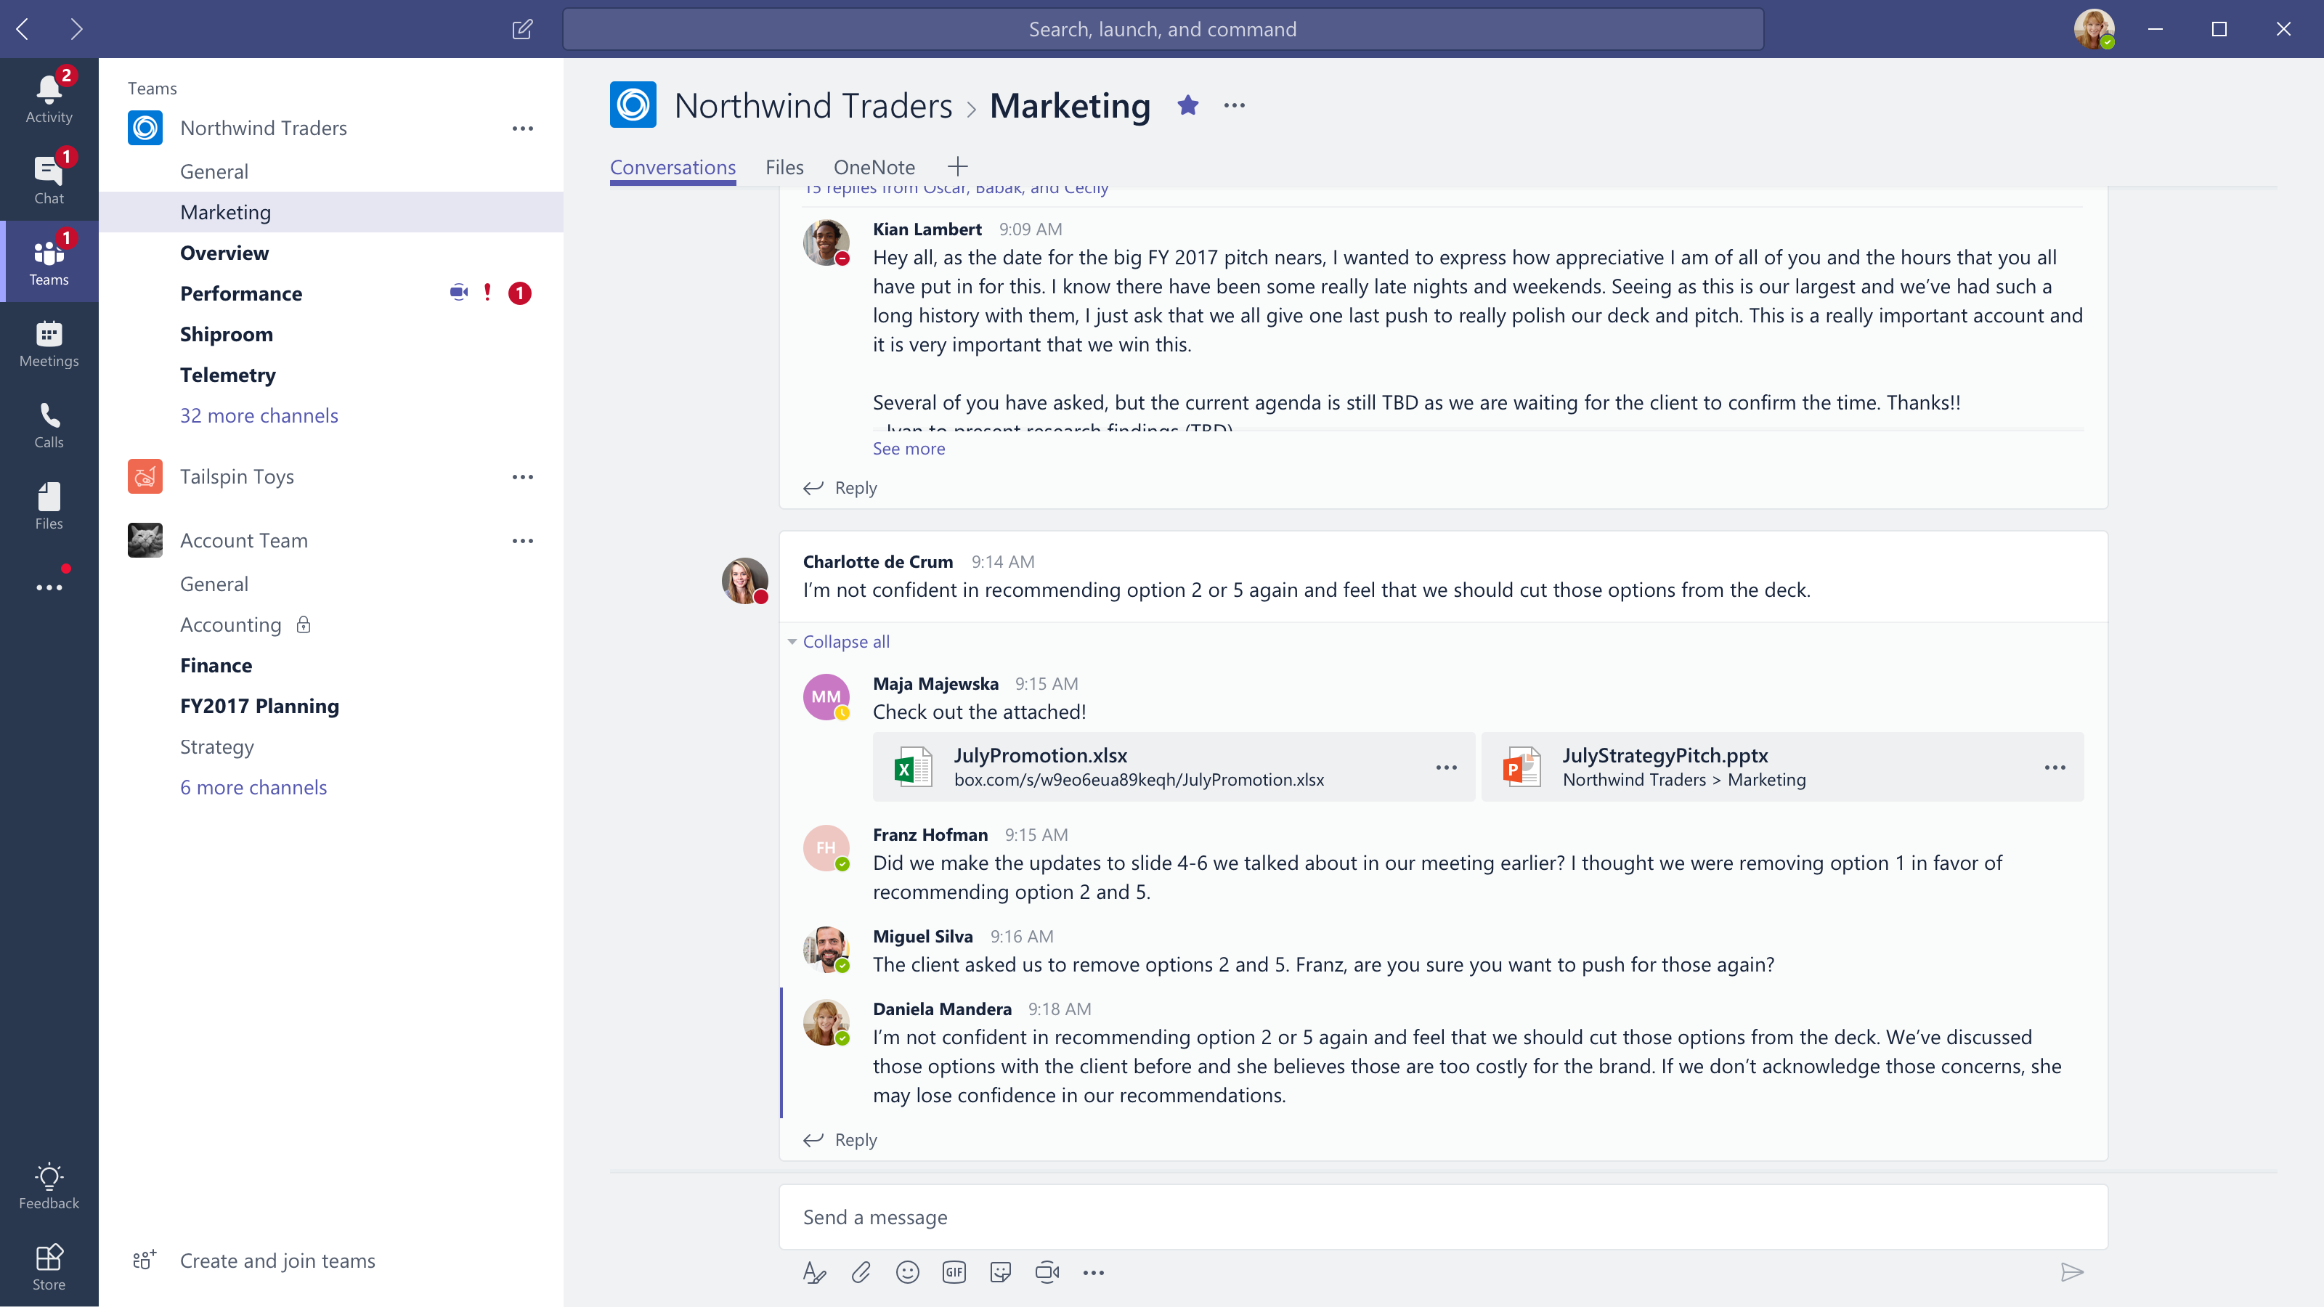











Microsoft Teams
The hub for teamwork in Office 365
Communicate
through chat, meetings & calls
Collaborate
with deeply integrated Office 365 apps
Customize & extend
with 3rd party apps, processes, and devices
Work with confidence
enterprise level security, compliance, and manageability
Notes:
[This is an animated slide. Please show it in presentation mode]
[MAIN POINT TO LAND]
Microsoft Teams is a hub for teamwork, a chat-based workspace that enables teams to be more productive by giving them a single and secure location that brings together everything a team needs: chats, meetings, calls, files, and tools. Microsoft Teams is one place for all the needs your teams have.
Microsoft Teams delivers on four core promises to create a digital workspace for high performing teams.
[COMMUNICATE]
First, Microsoft Teams solves for the communication needs of a diverse workforce.
Since preview, Microsoft Teams has evolved to include a complete meetings experience, as well as chat, voice and video -
You can use Teams for informal 1:1 or group chats – directly on your phone if you’re on the go. Or you can have an open conversation in a channel. This enables people to share information in a transparent way to accelerate decision making. And it's super easy to move from a chat into a face to face meeting, helping you to bridge geographical barriers.
[COLLABORATE]
When it comes to collaboration, the deep Office integration enables today’s multigenerational workforce to use the Office apps they are familiar with and love - Word, Excel, PowerPoint, OneNote, SharePoint, Planner, even Power BI - right within the context of Teams. Teams is unique in how we enable collaboration.
Today, when you want somebody’s feedback, you send them the file via email, they store it locally with comments, you store it again…… it's a vicious cycle that results in v2, v3, v4 versions – and you have to jump between email and other apps to get the work done. Teams brings all the Office 365 services together – so that you can easily share and co-author files without the need for email attachments.
[CUSTOMIZE]
Many of you use other services than Office 365 as well which results in you having to jump between and spend time in disparate experiences. We built Teams to not only be the hub for Office 365 services, but for all the services and tools teams use on a day to day basis. So, you can customize Teams with tabs, connector and bots to include the apps and services you need - <mention relevant 3rd party apps like GitHub and Trello that can be included in Teams>– we have integrations with over 150 partners. For our developer community, we have also created an extensible platform, to enable building apps and to integrate with business processes.
[WORK WITH CONFIDENCE]
Microsoft Teams comes with the enterprise grade security, compliance and manageability that you expect from Office 365 which customers tell us is a huge value add for them.

Slide 4
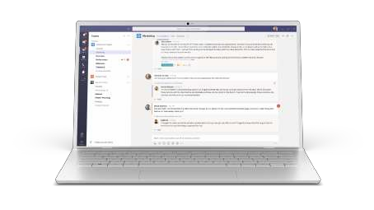
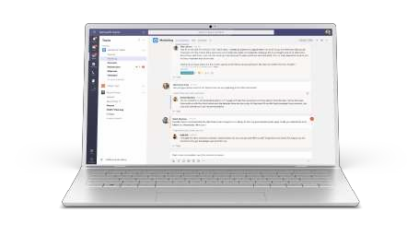
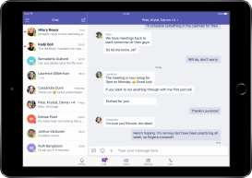


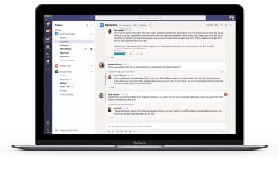





Cross platform presence – Teams where you want it
Desktop
Mobile
Browsers
Windows 7+
iPad
Edge
Chrome
Firefox
OS X 10.10+
iPhone
Android

Slide 5






STANDALONE WEB, DEVICE, AND SERVICE APPS
Conversation are Core to the Office 365 Platform
EXTENSIONS


EMBEDDED CANVASES
Microsoft Graph
External Data & Content

Slide 6




Enable your teams to make decisions and
take action faster
Make teamwork more productive with Teams Apps
HUB EXPERIENCE
Reduce context switching on important tasks
Create opportunities for collaboration around external content
1st Party Apps
3rd Party Apps
Custom Apps
Notes:
`

Slide 7
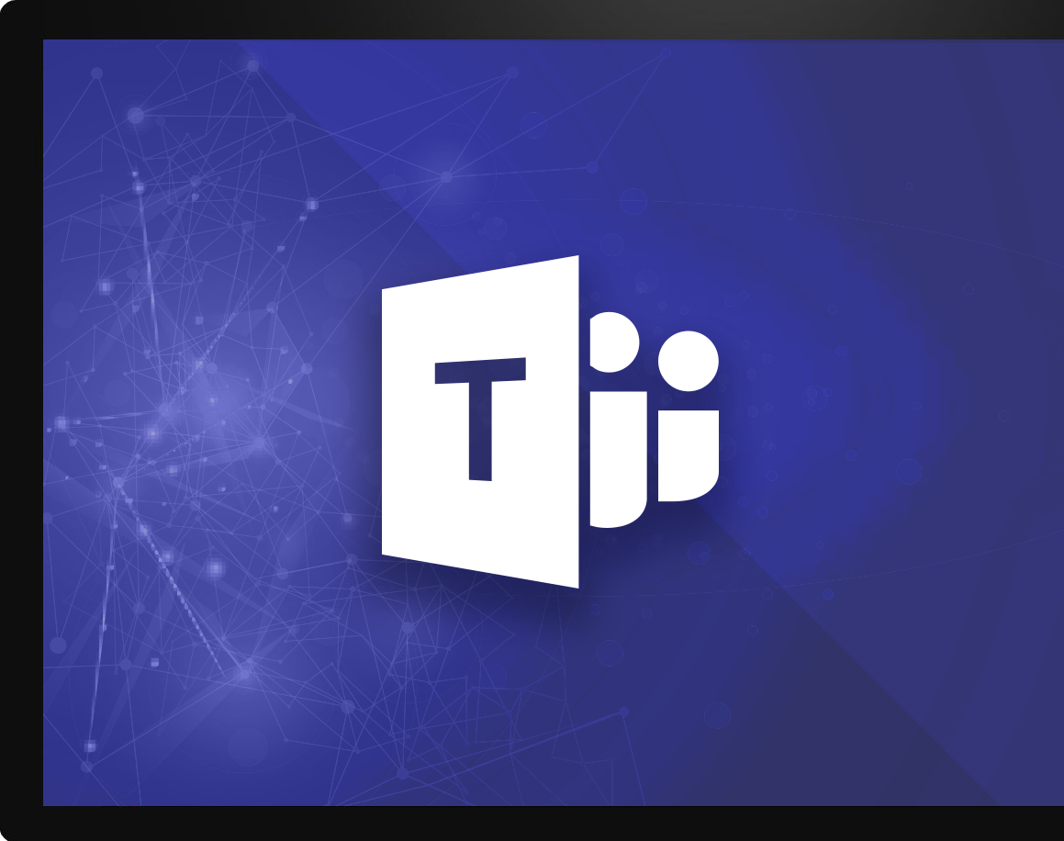
Microsoft Teams Platform
build experiences that people love
Communicate
through chat, meetings & calls
Collaborate
with deeply integrated Office 365 apps
Work with confidence
enterprise level security, compliance, and manageability
Customize & extend
Gain context without switching context
Meet your people where they are
Tailor your teamwork
with 3rd party apps, processes, and developer tools
Notes:
Talk track: And core to that are the investments we’ve made in the Teams Platform, allowing users & developers alike to customize and build on Teams, in order to deliver experiences that your people & customers LOVE.
And when it comes to the platform and the value that our customers are seeing from it, we are seeing three distinct categories emerging:
Gain context without switching context: Teams pillar of integration (the single hub for Office) but also the ability to simply curate your experience so you reduce the information overload you get every day and focus on the content that's most relevant to you to get your job done, better. INFUSION
Meet Your people where they are: Bring together all the apps and tools your organization is already using, into one user interface. Guess what, for IT that means better & easier management, reduced security threats, and more time you can spend on valuable, forward-looking projects. For end users, #1 just got even better. (opportunity to share a 3rd party apps slide here)
Tailoring your experience: to me, this delivers superpowers to people through proactive intelligence. This is the core to the extensibility of the Teams platform. Deliver intelligent experiences using our APIs and/or our partner community that:
First: make the most difficult and time-wasting tasks at work, easy
Thereafter: drive intelligence to your people that allows them to understand how they add more value to the organization, and then deliver it more efficiently & quickly

Slide 8







Real Digital Transformation
your app/service
tabs
connectors
adaptive cards
task modules
bots
messaging extensions
notifications
graph
personal scope
team scope
Microsoft Teams
Notes:
Tabs - Surface rich content as well as SharePoint Framework based solutions
Connectors - Post rich updates to channels
Adaptive Cards - Add rich interaction to your connector cards
Bots - Help users get tasks done in conversations
Message Extensions - Allow users to query and share rich cards in conversations
Notifications - Engage users via feed notifications
------
Graph - Build in intelligence and connect to data that drives productivity
Apps Store - Drive engagement by submitting your app to our app store or just to certain company stores

Slide 9


Microsoft Teams provides a powerful and extensible platform
Build apps using rich capabilities to empower your users in chat, channels, and personal workspace
Distribute and manage your app
Enterprise Developers
Upload to your organization’s app catalog
Tabs
Bots
Surface rich content within Teams
Help users get tasks done in conversations
ISV / SI / MSP Partners
Publish to AppSource to make available in the Teams app store
Messaging Extensions
Notifications
Allow users to query and share rich cards in conversations
Post rich updates to channels via connectors
Administrators
Assign policy for apps over end users. Preinstall and pre-pin apps to drive adoption
Adaptive Cards
Q
Voice and video
Add rich interaction to your connector cards
Add rich calling and meeting automation and media
Microsoft Graph
Power your apps using Graph. Build intelligence and connect to data that drives productivity
Notes:
Microsoft Teams has an open developer platform with a rich set of capabilities to build apps or integrate with new or existing business processes and services.

Slide 10
Teams apps in various contexts
Team and channel
Enable public collaboration and workflows with all team members
Example: share, discuss, and get notified about new service incidents
Custom-tailor your app’s functionality depending on which of these contexts you will support
Chat
Lightweight collaboration in 1:1 or group setting without complex permissions
Example: 1:1 topics between manager and direct report
Personal
User-centric view, showing aggregate content along with private bot chat
Example: list of all tasks assigned to me

Slide 11
Bots in Microsoft Teams
Conversations
Notification-Only Bots
Sending and Receiving Files

Slide 12
Conversations
Series of messages sent between your bot and one or more users. Conversations are in one of the following scopes:
Teams
Also called channel conversations, visible to all members of the channel.
Personal
Conversations between bots and a single user.
Group chat
Chat between a bot and two or more users.

Slide 13
Bot Events in Microsoft Teams
Activity objects are used to pass information back and forth between bot and channel (or user). Activities can represent Events, denoted by ActivityType == ‘conversationUpdate’
Team Member Events
teamMemberAdded
teamMemberRemoved
Payload object contains added/removed members
*Adding bot fires this event
Channel Events
channelCreated
channelRenamed
channelDeleted
ChannelData object reflects current state
Team Events
teamRenamed
ChannelData object reflects current state
Reactions
reactionsAdded
reactionsRemoved
replyToId contains the ID of the specific message
Notes:
Teams will send notifications to your bot for changes or events that happen in contexts where your bot is active. You can use these events to trigger service logic, such as:
Trigger welcome message when your bot is added to a team.
Query and cache team information when the bot is added to a team.
Updated cached information on team membership or channel information changes.
Remove cached information for a team if the bot is removed.
Since bot is scoped to team, no events for team creation/deletion provided.
When bot is added/removed, TeamMember events are sent.

Slide 14
Teams Context
Your bot can access additional context about the team or chat, such as user profile. This information can be used to enrich your bot's functionality and provide a more personalized experience.
Members in conversation
var mbrs = await connector.Conversations .GetConversationMembersAsync(
message.Conversation.Id );
foreach (var mbr in mbrs.AsTeamsChannelAccounts())
{
[...]
}
Channels in Team
ConversationList channels = client .GetTeamsConnectorClient() .Teams .FetchChannelList( activity.GetChannelData<TeamsChannelData>() .Team.Id );
Notes:
Use the Microsoft.Bot.Connector.Teams package to get extension methods for Microsoft Teams. Handles the parsing of the Bot Framework payload with Teams-specific functionality.

Slide 15
Proactive Messaging
A proactive message is an activity sent by a bot to start a conversation
Start Personal conversation
Must have user’s information cached
From team roster
From previous interaction with user
From conversationUpdate events
Use the CreateOrGetDirectConversation method
Start Channel conversation
Must have channel information cached
From previous interaction in channel
From conversationUpdate events
To create conversation:
Create ConnectorClient with service Uri
Call connector.Conversations.CreateConversationAsync, passing channel account for bot
Set Conversation property of new message
Call connector.Conversations.SendToConversationAsync
Notes:
Personal conversation requires User Id (from Teams) and Tenant Id

Slide 16
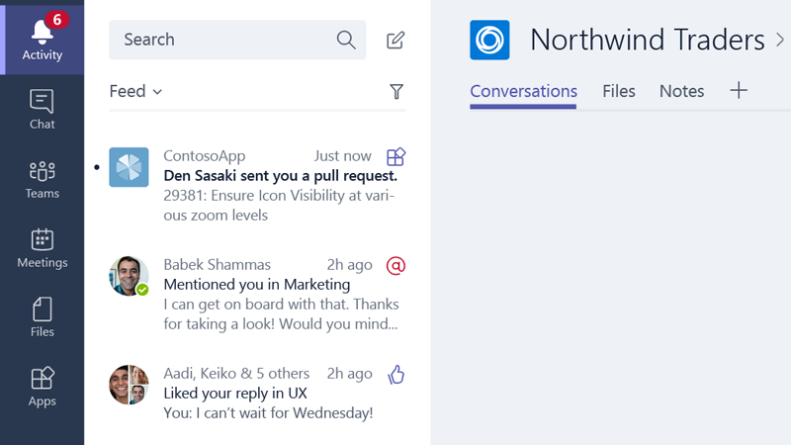
Activity Feed
Optionally send personal chat messages into the feed as preview cards summarizing your app's activity.
Construct the message such that choosing the card navigates the user straight to the message or object that triggered the notification, such as an entity in a tab.
Must include Text and Summary properties

Slide 17
Notification only bots
"bots": [ { "botId": "[MicrosoftAppId]", "scopes": [ "personal", "team" ], "isNotificationOnly": true, } ]
Bots can update the activity feed
If the sole purpose of the bot is to deliver notifications, consider a notification only bot.
Users cannot message your notification-only bot
Users cannot @mention the bot
bots node
isNotificationOnly property

Slide 18
Send and Receive file
Sending and receiving files through a bot can be accomplished via two different APIs
Microsoft Graph API
Obtain access to OneDrive folder (user or group drive)
Get reference to file
Post message to conversation with card attachment
Microsoft Teams API
Personal context (1:1) only
Enable files in manifest
Teams client provides a file picker experience
Teams client will store file in OneDriveCreate and then post activity with metadata, including content URL
Bot must download and handle file as appropriate
Notes:
Personal conversation requires User Id (from Teams) and Tenant Id

Slide 19
Enable send and receive
"bots": [ { "botId": "[MicrosoftAppId]", "scopes": [ "personal", "team" ], "supportsFiles": true, } ]
Teams client will handle file selection and storage
Handles scenario User -> Bot
bots node
supportsFiles property

Slide 20
Bot Demo

Slide 21
Messaging Extensions
Events and Queries
Responding to User Requests
Message Extensions in App Manifest

Slide 22
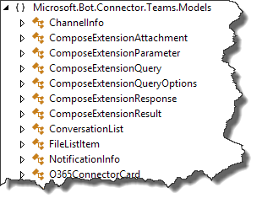
Events and Queries
Activity payload
Type is invoke
Name identifies type of event
composeExtension/query
composeExtension/querySettingUrl
composeExtension/setting
Sent to registered bot endpoint
Teams Connector NuGet package provides detection methods and data models

Slide 23
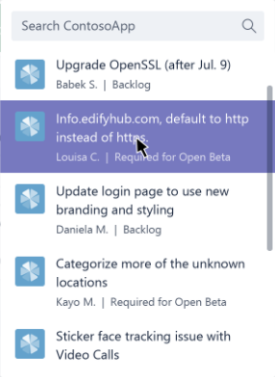
Events and Queries
Query events
Query data sent to bot
Activity.GetComposeExtensionQueryData()
Verify commandId and parameters
Use parameter value to query your service
Respond with attachment layout of “List”
Adaptive Card
Hero Card
Thumbnail Card
O365Connector Card

Slide 24
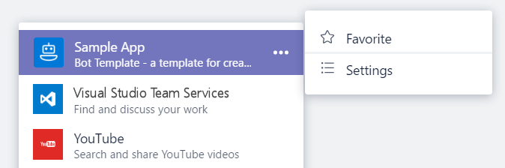
Events and Queries
Settings events
If canUpdateConfiguration is true, Teams will send Settings events in response to user action
onQuerySettingsUrl
Sent when “Settings” clicked
Return Url of settings page
Teams will render page
onSettingsUpdate
Sent when settings page is closed
Storage of settings is developer responsibility

Slide 25
Responding to User Requests
Service must respond within 5 seconds.
Response is not an activity sent via the Bot Framework.
Response is an HTTP Response:
HTTP Status of 200
Content type application/json
Response body must contain a valid composeExtension object.

Slide 26
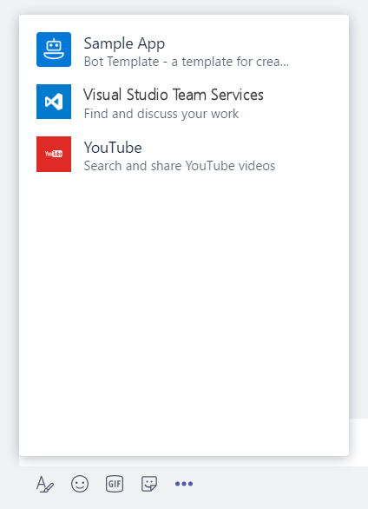
Message Extensions in App Manifest
"composeExtensions": [ { "botId": "[MicrosoftAppId]", "scopes": [ "team" ], "canUpdateConfiguration": true, "commands": [ { "id": "searchCmd", "description": "Search Bot Channels", "title": "Bot Channels", "initialRun": false, "parameters": [ { "name": "searchText", "description": "Enter your search text", "title": "Search Text“ } ] } ] } ]
composeExtension node
Associated with a registered application
Personal and Team scopes
Define command UI and parameter
Multiple extensions
Your extension shown along with all others added to Teams
Notes:
commandExtension is part of the manifest.json file
Scope determines if 1:1 (personal) or channel (team)

Slide 27
Messaging Extensions Demo

Slide 28
Using Cards in Microsoft Teams
Using Cards in Bots
Using Cards in Messaging Extensions
Adaptive Cards support in Microsoft Teams

Slide 29

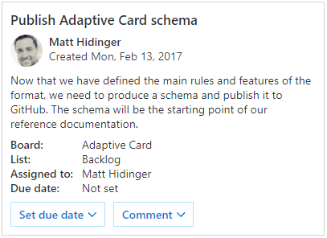
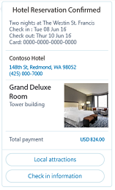
Using Cards in Bots
Adaptive Card
A customizable card that can contain any combination of text, speech, images, buttons, and input fields.
Supported in Teams, Outlook, Windows, etc.
Hero
Largest card
Best used for articles, long descriptions or scenarios where your image is telling most of the story
Receipt
A card that enables a bot to provide a receipt to the user. It typically contains the list of items to include on the receipt, tax and total information, and other text.
Notes:
This is a sample of cards that can be used. Refer to https://docs.microsoft.com/en-us/microsoftteams/platform/concepts/cards/cards-reference for details

Slide 30
Using Cards in Messaging Extensions
Respond with attachment layout of “List”
Format each query result as a card
Adaptive Card
Hero Card
Thumbnail Card
O365Connector Card
Do not include actions

Slide 31
Adaptive Cards support in Microsoft Teams
Microsoft Teams supports three action types for Adaptive cards:
Action.OpenUrl
Action.Submit
Action.ShowCard
Actions other than these are not supported

Slide 32
Cards Demo

Slide 33
Using Tabs in Microsoft Teams
Using Cards in Bots
Using Cards in Messaging Extensions
Adaptive Cards support in Microsoft Teams

Slide 34
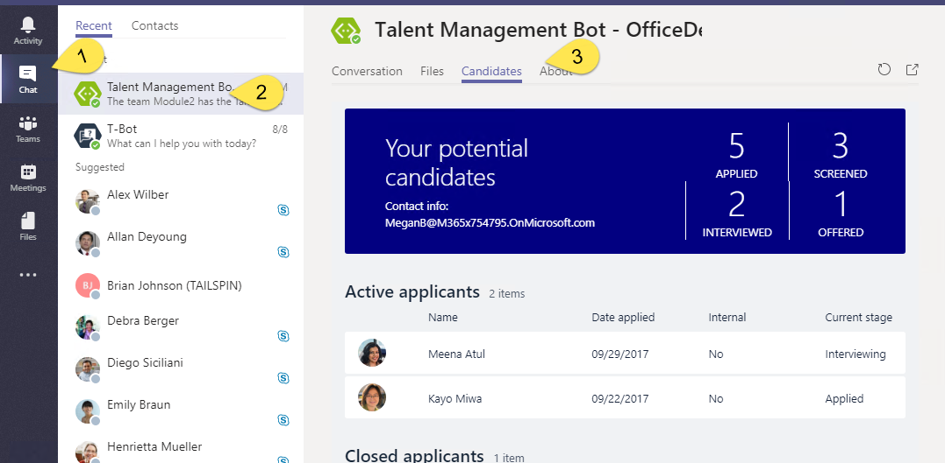
Static Tabs
A content page declared directly in manifest
No Configuration
Added in “personal” scope
Accessed via the app bar or alongside bot conversation

Slide 35
Static Tabs - Manifest
"staticTabs": [ { "entityId": "candidatesTab", "name": "Candidates", "contentUrl": "https://.../Tabs/candidates.html", "websiteUrl": "https://.../Tabs/candidates.html?web=1", "scopes": [ "personal" ] } ],
"validDomains": [ "token.botframework.com" ]
staticTabs node
contentUrl is hosted in IFRAME in Teams
websiteUrl is used as target for link
validDomains node
A list of valid domains from which the extension expects to load any content.

Slide 36
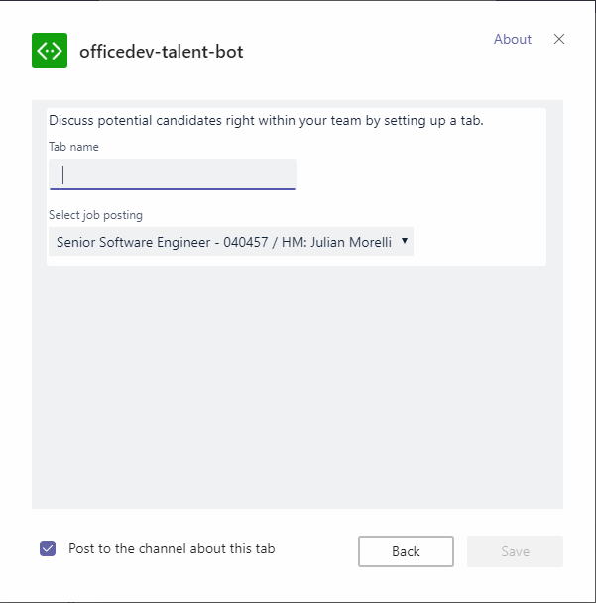
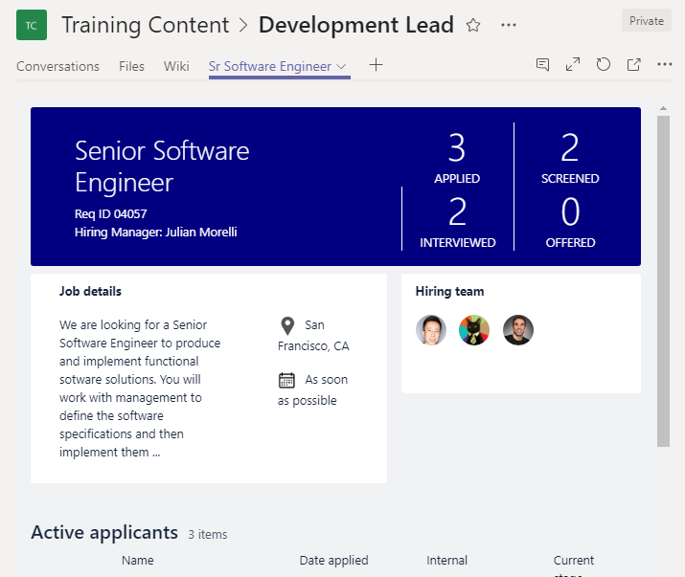
Tab Configuration and Content
Tab Configuration
Configured in manifest
Displayed when Tab added to Channel
Collect information
Call setSettings() specifying Content Url and Entity Id
Tab Content
Rendered in IFRAME
Url specified by configuration page
Inspect context for EntityId/SubEntityId
Retrieve state based on Entity/SubEntity/User
Notes:
To provide a seamless tab experience, perform provisioning and authorization on configuration page when possible.
If context has entity/subentity, then respond to a deeplink
State storage is developer’s responsibility

Slide 37
Tabs Demo

Slide 38

Enjoy the Bootcamp

Slide 39

Call to action
Share your feedback on Bootcamp at https://aka.ms/Microsoft365DevBootcampSurvey2019
Join Office 365 developer program https://dev.office.com/devprogram to leverage all resources for Office 365 development learning
Build applications on Office 365 platform
Attend MVP led local community events to continue learning on Office 365 development

